Slide 1
3
Structured Program
Development
Objectives
In this chapter, you’ll:
Use basic problem-solving techniques.
Develop algorithms through the process of top-down, stepwise refinement.
Select actions to execute based on a condition using the if and if…else selection statements.
Execute statements in a program repeatedly using the while iteration statement.
Use counter-controlled iteration and sentinel controlled iteration.
Use structured programming techniques.
Use increment, decrement and assignment operators.
Continue our presentation of Secure C programming.

Slide 2
3.1 Introduction
Before writing a program to solve a problem, you must have a thorough understanding of the problem and a carefully planned solution approach.

Slide 3
3.2 Algorithms
The solution to any computing problem involves executing a series of actions in a specific order. An algorithm is a procedure for solving a problem in terms of
1. the actions to execute, and
2. the order in which these actions should execute.

Slide 4
3.3 Pseudocode
Pseudocode is an informal artificial language similar to everyday English that helps you develop algorithms before converting them to structured C programs.
Pseudocode is convenient and user friendly. It helps you “think out” a program before writing it in a programming language. Computers do not execute pseudocode.
Pseudocode describes the actions and decisions that will execute once you convert the pseudocode to C and run the program.

Slide 5
3.4 Control Structures
Normally, statements in a program execute one after the other in the order in which you write them. This is called sequential execution.
all programs could be written in terms of three control structures, namely the sequence structure, the selection structure and the iteration structure.
Flowcharts
A flowchart is a graphical representation of an algorithm or of a portion of an algorithm. Flowcharts help you develop and represent algorithms, although pseudocode is preferred by most programmers. Flowcharts clearly show how control structures operate.

Slide 6
3.4 Control Structures
Selection Statements in C
C provides three types of selection structures in the form of statements:
• The if single-selection statement (Section 3.5) selects (performs) an action (or group of actions) only if a condition is true.
• The if…else double-selection statement (Section 3.6) performs one action (or group of actions) if a condition is true and a different action (or group of actions) if the condition is false.
• The switch multiple-selection statement (discussed in the next chapter) performs one of many different actions, depending on the value of an expression.

Slide 7
3.4 Control Structures
Iteration Statements in C
C provides three types of iteration structures in the form of statements, namely while, do…while, and for. These statements perform tasks repeatedly.
We discuss do…while and for in the next chapter. C provides three types of selection structures in the form of statements:

Slide 8
3.5 The if Selection Statement
Selection statements choose among alternative courses of action. For example, suppose the passing grade on an exam is 60.
The following pseudocode statement determines whether the condition “student’s grade is greater than or equal to 60” is true or false:
If true, then “Passed” is printed, and the next pseudocode statement in order is “performed.” Remember that pseudocode isn’t a real programming language.
If false, the printing is ignored, and the next pseudocode statement in order is performed.
If student’s grade is greater than or equal to 60
Print “Passed”

Slide 9
3.5 The if Selection Statement
if Statement Flowchart
The following flowchart segment illustrates the single-selection if statement:

Slide 10
3.6 The if…else Selection Statement
The if…else selection statement specifies different actions to perform when the
condition is true or false. For example, the pseudocode statement
prints “Passed” if the student’s grade is greater than or equal to 60; otherwise, it prints “Failed.”
if…else Statement Flowchart
The flowchart illustrates the
if…else statement’s flow of control:
If student’s grade is greater than or equal to 60
Print “Passed”
else
Print “Failed”

Slide 11
3.6 The if…else Selection Statement
Conditional Expressions
The conditional operator (?:) is closely related to the if…else statement. This operator
is C’s only ternary operator—that is, it takes three operands.
The first operand is a condition.
The second is the conditional expression’s value if the condition is true.
The third is the conditional expression’s value if the condition is false.

Slide 12
3.6 The if…else Selection Statement
Conditional Expressions
The conditional operator (?:) is closely related to the if…else statement. This operator
is C’s only ternary operator—that is, it takes three operands.
The first operand is a condition.
The second is the conditional expression’s value if the condition is true.
The third is the conditional expression’s value if the condition is false.

Slide 13
3.6 The if…else Selection Statement
Conditional Expressions
The conditional operator (?:) is closely related to the if…else statement. This operator
is C’s only ternary operator—that is, it takes three operands.
The first operand is a condition.
The second is the conditional expression’s value if the condition is true.
The third is the conditional expression’s value if the condition is false.

Slide 14
3.6 The if…else Selection Statement
Nested if...else Statements
Nested if…else statements test for multiple cases by placing if…else statements inside if…else statements.

Slide 15
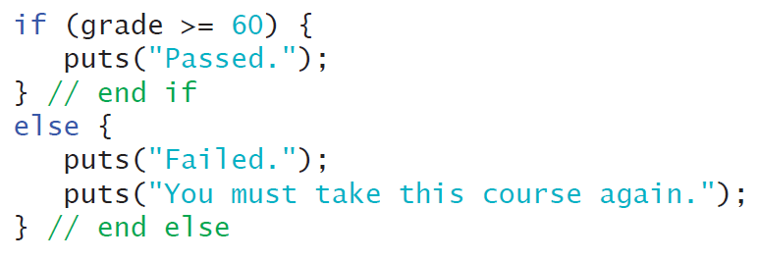
3.6 The if…else Selection Statement
Blocks and Compound Statements
To include several statements in an if’s body, you must enclose the statements in braces ({ and }). A set of statements contained within a pair of braces is called a compound statement or a block.

Slide 16

3.6 The if…else Selection Statement
Kinds of Errors
A syntax error (such as misspelling “else”) is caught by the compiler. A logic error has its effect at execution time.
Empty Statement
Anywhere a single or compound statement can be placed, it’s possible to place an empty statement, represented by a semicolon (;).

Slide 17
3.7 The while Iteration Statement
An iteration statement (also called a repetition statement or loop) repeats an action while some condition remains true. The pseudocode statement.
describes the iteration that occurs during a shopping trip.
The condition “there are more items on my shopping list” may be true or false.
If it’s true, the shopper performs the action “Purchase next item and cross it off my list” repeatedly while the condition remains true.
Eventually, the condition will become false (when the last item on the shopping list has been purchased and crossed off the list).
At this point, the iteration terminates, and the first pseudocode statement after the iteration statement “executes.”
While there are more items on my shopping list
Purchase next item and cross it off my list

Slide 18
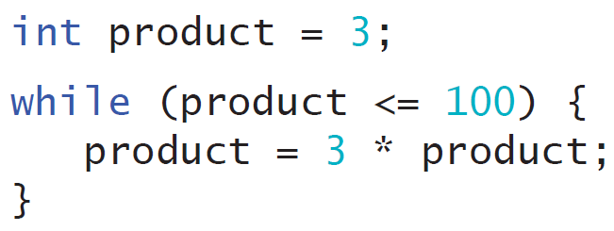
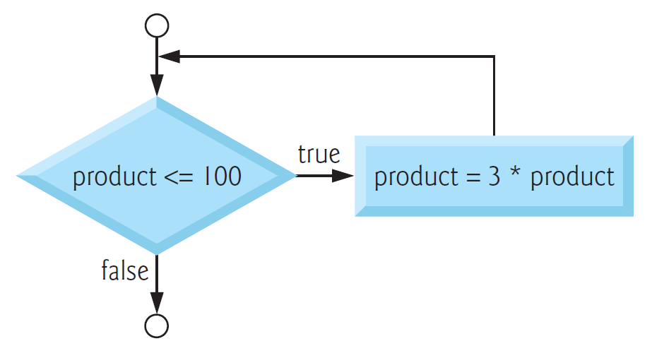
3.7 The while Iteration Statement
Calculating the First Power of 3 Greater Than 100
As a while statement example, consider a program segment that finds the first power of 3 larger than 100.
while Statement Flowchart
The following flowchart segment illustrates the preceding while iteration statement:

Slide 19
3.8 Case Study 1: Counter-Controlled Iteration
A class of ten students took a quiz. The grades (integers in the range 0 to 100) for this quiz are available to you. Determine the class average on the quiz .
Pseudocode for the Class-Average Problem
Set total to zero
Set grade counter to one
While grade counter is less than or equal to ten
Input the next grade
Add the grade into the total
Add one to the grade counter
Set the class average to the total divided by ten
Print the class average

Slide 20
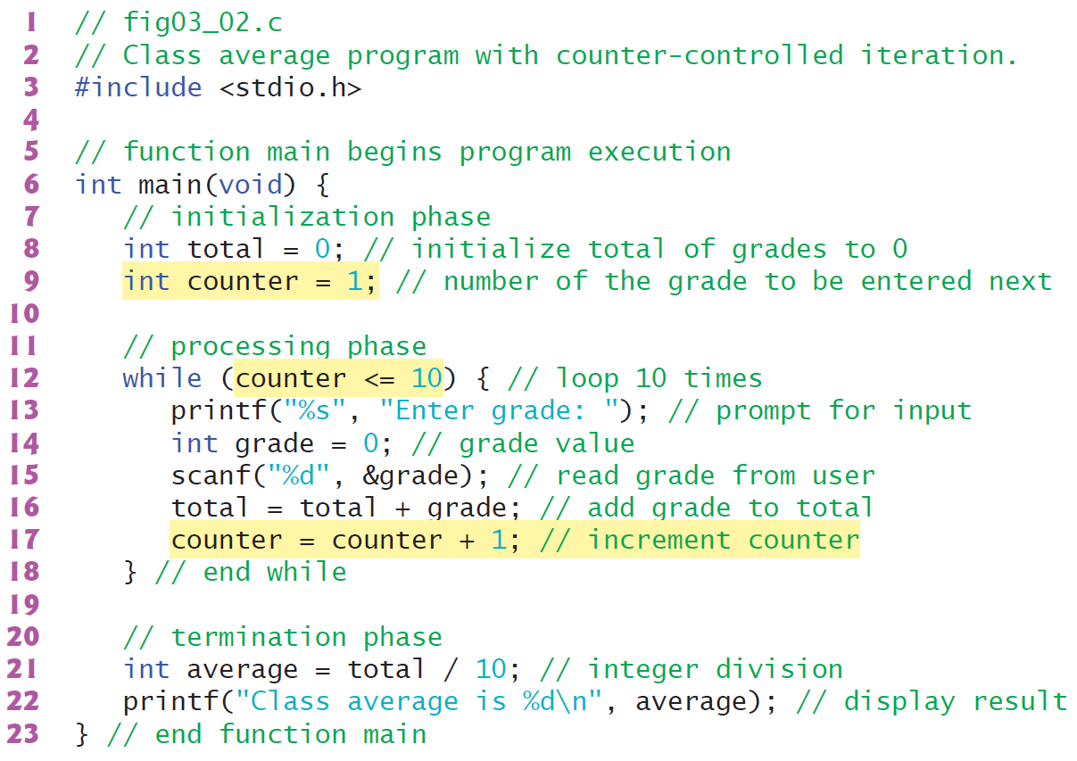
3.8 Case Study 1: Counter-Controlled Iteration

Slide 21
3.8 Case Study 1: Counter-Controlled Iteration

Slide 22
3.8 Case Study 1: Counter-Controlled Iteration

Slide 23
3.8 Case Study 1: Counter-Controlled Iteration

Slide 24
3.9 Case Study 2: Sentinel-Controlled Iteration
Develop a class-averaging program that will process an arbitrary number of grades each time the program is run.
Pseudocode
for the
Class-Average Problem
Initialize total to zero
Initialize counter to zero
Input the first grade (possibly the sentinel)
While the user has not as yet entered the sentinel
Add this grade into the running total
Add one to the grade counter
Input the next grade (possibly the sentinel)
If the counter is not equal to zero
Set the average to the total divided by the counter
Print the average
else
Print “No grades were entered”
This program introduces the data type double to handle numbers with decimal points—that is, floating-point numbers.
Further, a cast operator to force the averaging calculation to use floating-
point numbers.

Slide 25
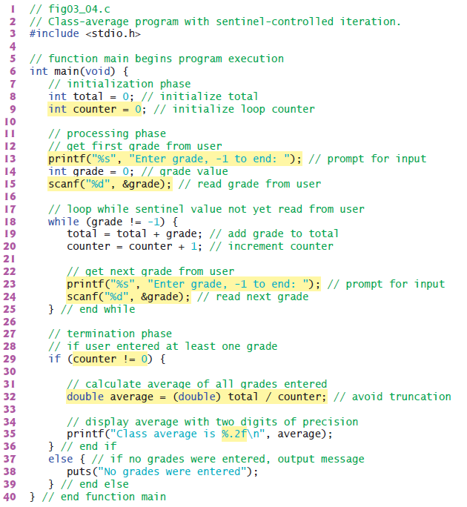
3.9 Case Study 2: Sentinel-Controlled Iteration

Slide 26
3.9 Case Study 2: Sentinel-Controlled Iteration
Converting Between Types Explicitly and Implicitly
Dividing two ints results in integer division—any fractional part of the calculation is truncated (that is, lost). You can produce a floating point calculation with integer values by first creating temporary floating-point numbers.
C provides the unary cast operator to accomplish this task.
The cast operator, (double), creates a temporary floating-point copy of its operand, total. The value stored in total is still an integer. Using a cast operator in this manner is called explicit conversion.
In mixed-type expressions, the compiler performs an operation called implicit conversion on selected operands to ensure that they’re of the same type.
For example, in an expression containing the data types int and double, copies of int operands are made and implicitly converted to type double.

Slide 27
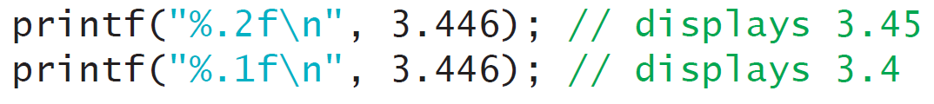
3.9 Case Study 2: Sentinel-Controlled Iteration
Formatting Floating-Point Numbers

Slide 28
3.10 Case Study 3: Nested Control Statements
A college offers a course that prepares students for the state licensing exam for real estate brokers. Last year, 10 of the students who completed this course took the licensing examination. Naturally, the college wants to know how well its students did on the exam. You’ve been asked to write a program to summarize the results. You’ve been given a list of these 10 students. Next to each name is a 1 if the student passed the exam or a 2 if the student failed.
Your program should analyze the results of the exam as follows:
Input each test result (i.e., a 1 or a 2). Display the prompting message “Enter result” each time the program requests another test result.
Count the number of test results of each type.
Display a summary of the test results indicating the number of students who passed and the number who failed.
If more than eight students passed the exam, print the message “Bonus to instructor!”

Slide 29
3.10 Case Study 3: Nested Control Statements
Pseudocode
Initialize passes to zero
Initialize failures to zero
Initialize student to one
While student counter is less than or equal to ten
Input the next exam result
If the student passed
Add one to passes
else
Add one to failures
Add one to student counter
Print the number of passes
Print the number of failures
If more than eight students passed
Print “Bonus to instructor!”

Slide 30
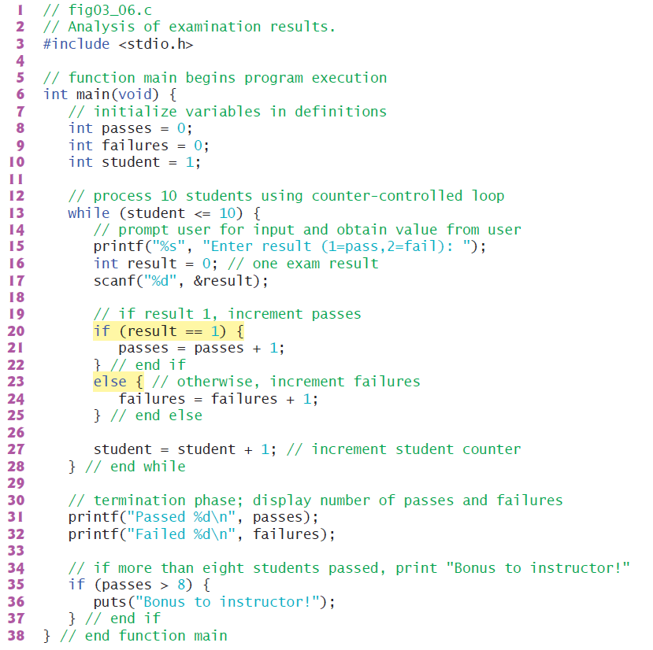
3.10 Case Study 3: Nested Control Statements

Slide 31
3.10 Case Study 3: Nested Control Statements

Slide 32
3.10 Case Study 3: Nested Control Statements

Slide 33
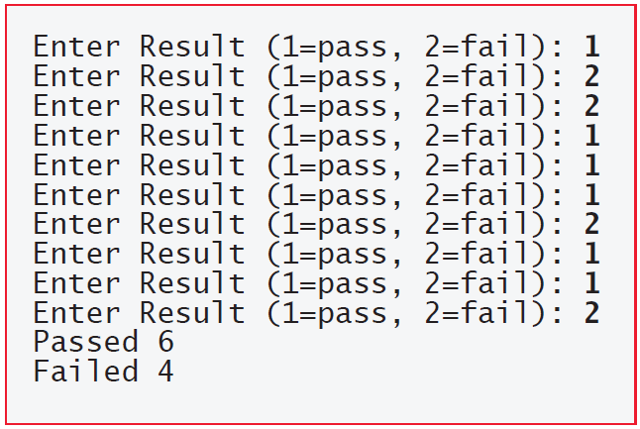
3.10 Case Study 3: Nested Control Statements

Slide 34
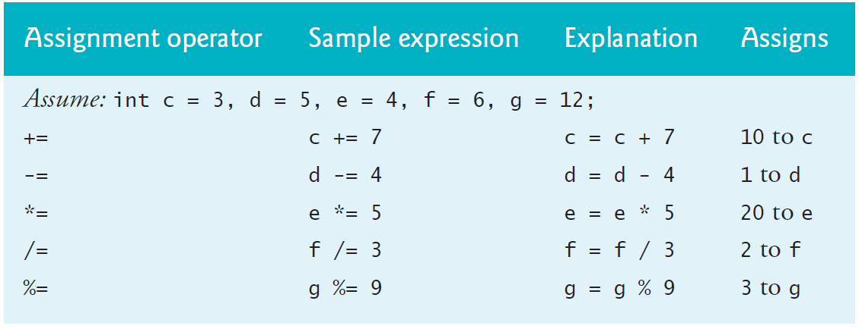
3.11 Assignment Operators
Pseudocode
C provides several assignment operators for abbreviating assignment expressions. For example, the statement
c = c + 3;
can be abbreviated with the addition assignment operator += as
c += 3;

Slide 35
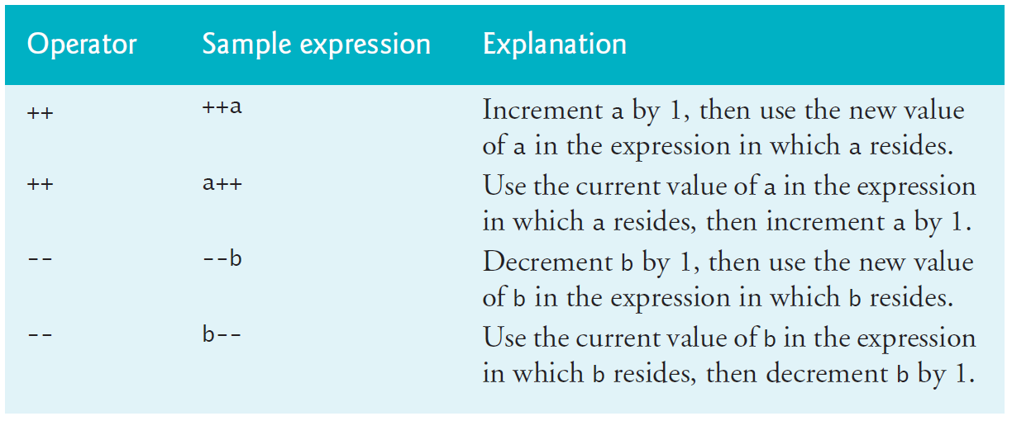
3.12 Increment and Decrement Operators
The unary increment operator (++) and the unary decrement operator (--) add one to and subtract one from an integer variable, respectively.

Slide 36
3.12 Increment and Decrement Operators

